Slide 1
WELCOME TO Computer consulting
TARIKH MAHDI
ID: 1207353

Slide 2

HOME PAGE

Slide 3
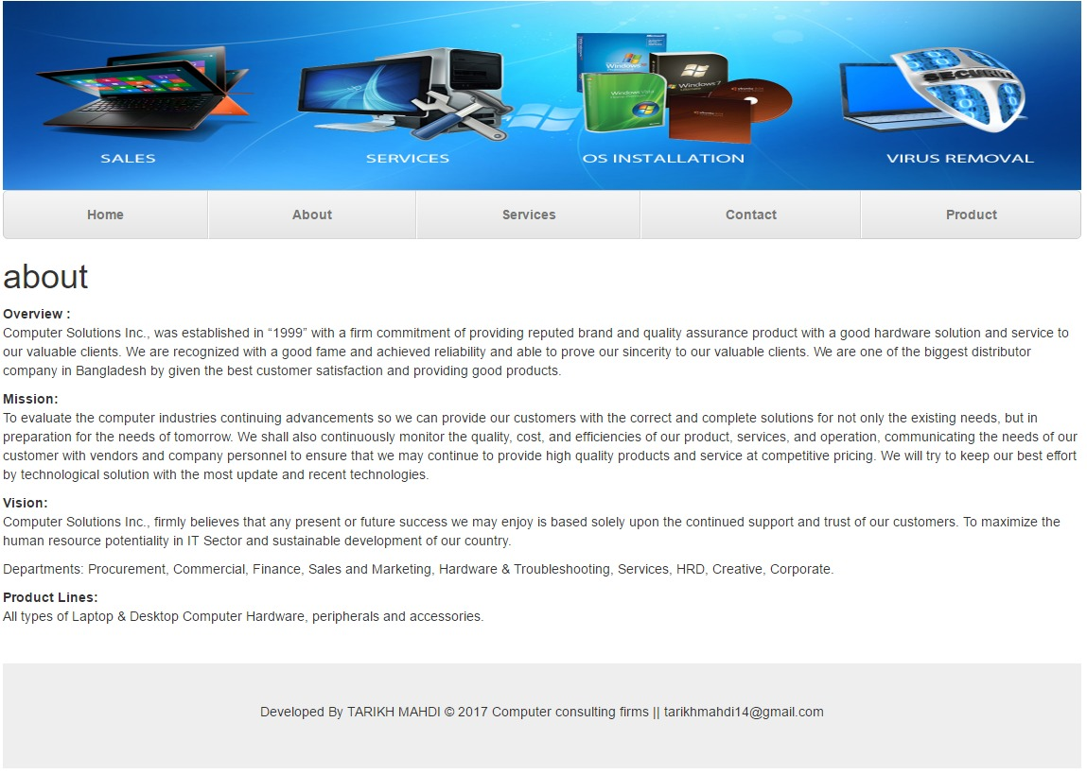
About Us

Slide 4
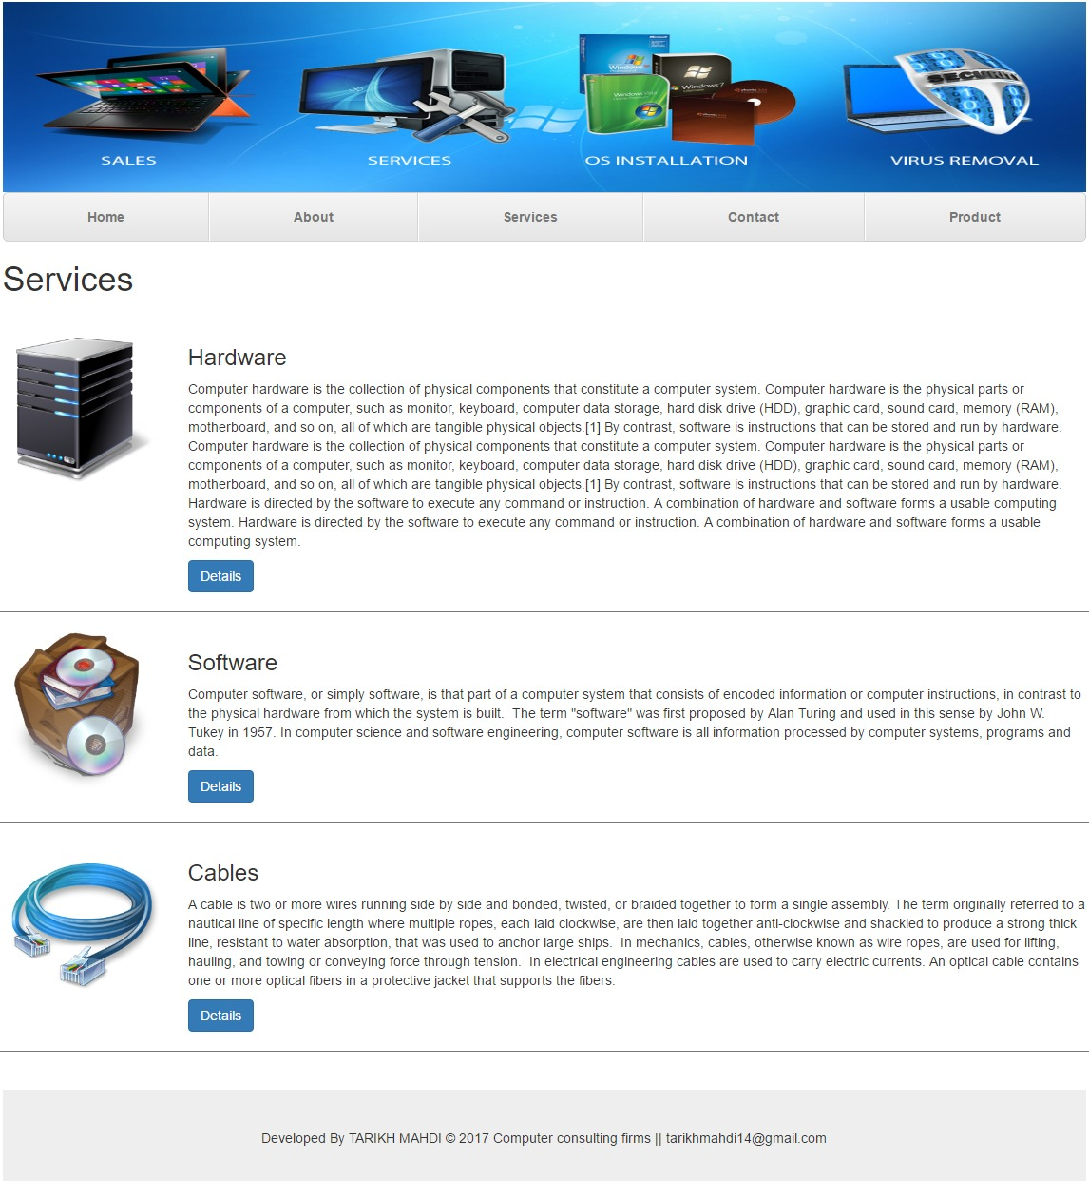
Services

Slide 5
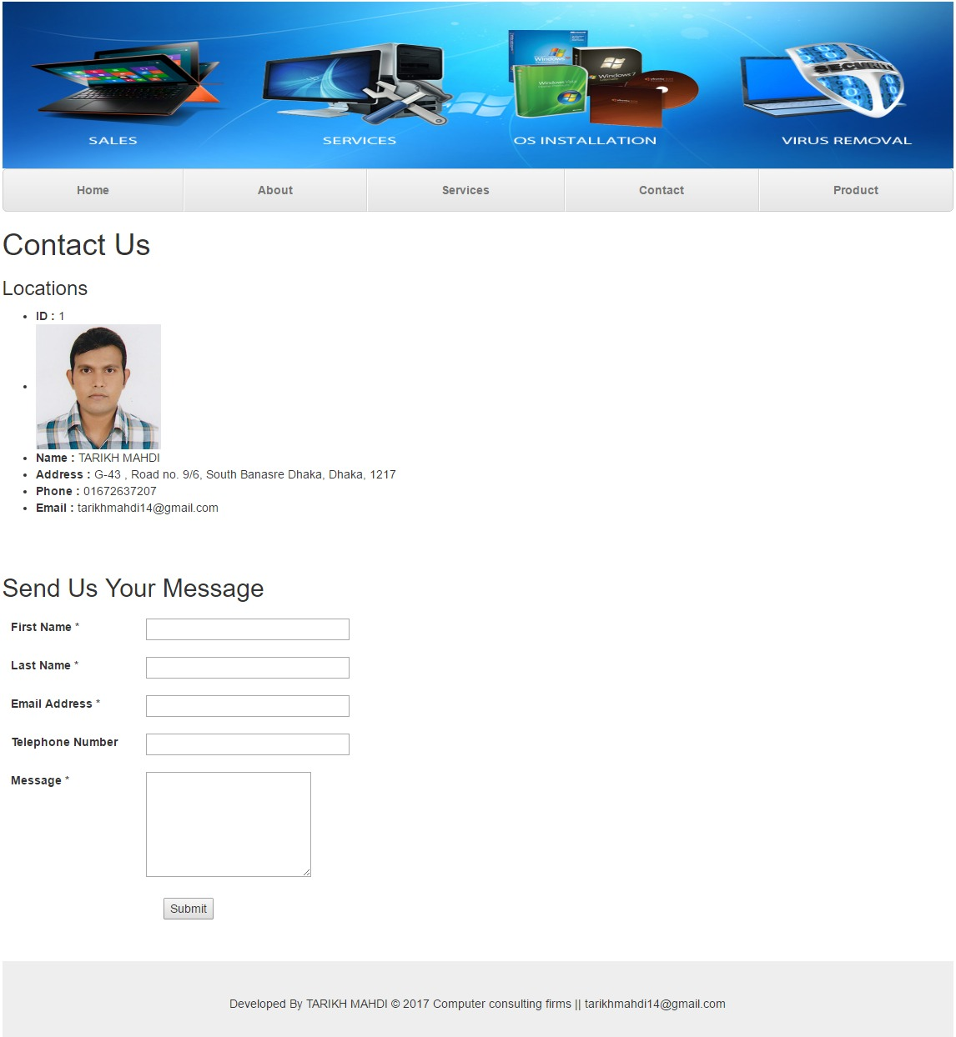
Contact Page

Slide 6
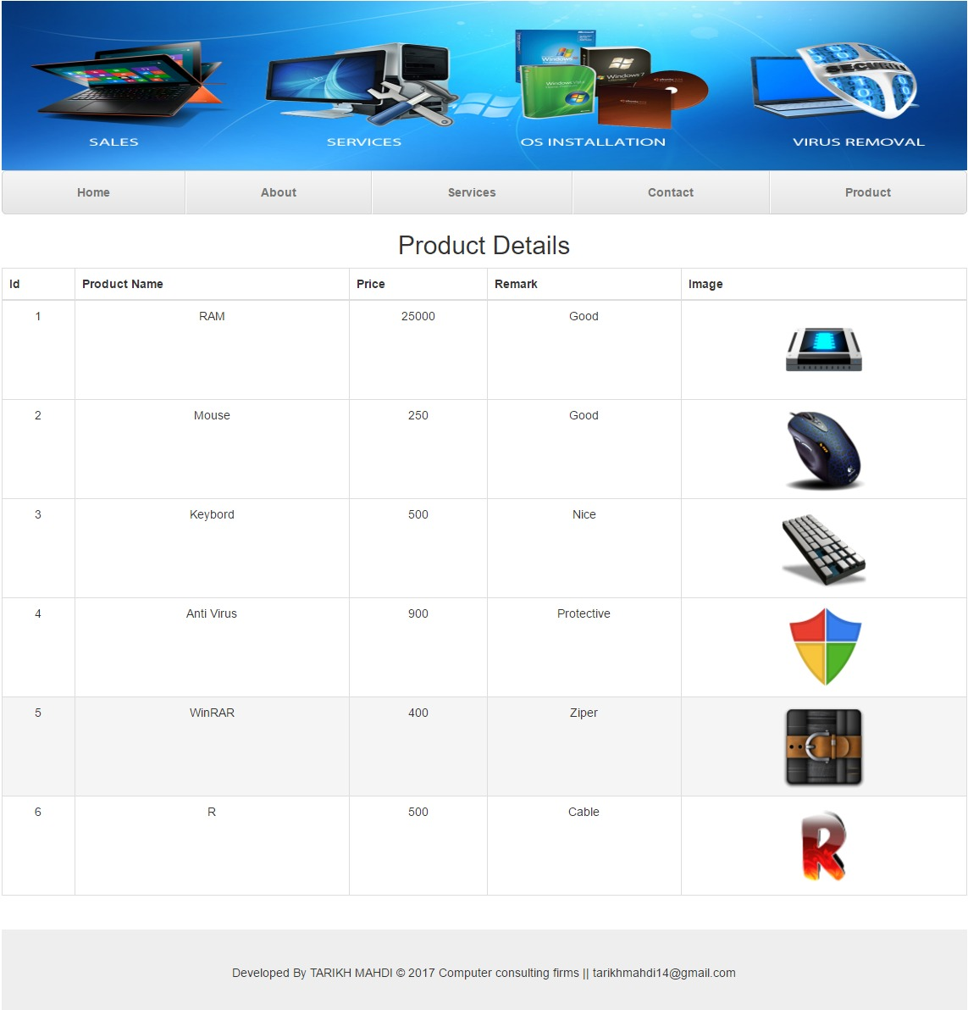
Product Details

Slide 7
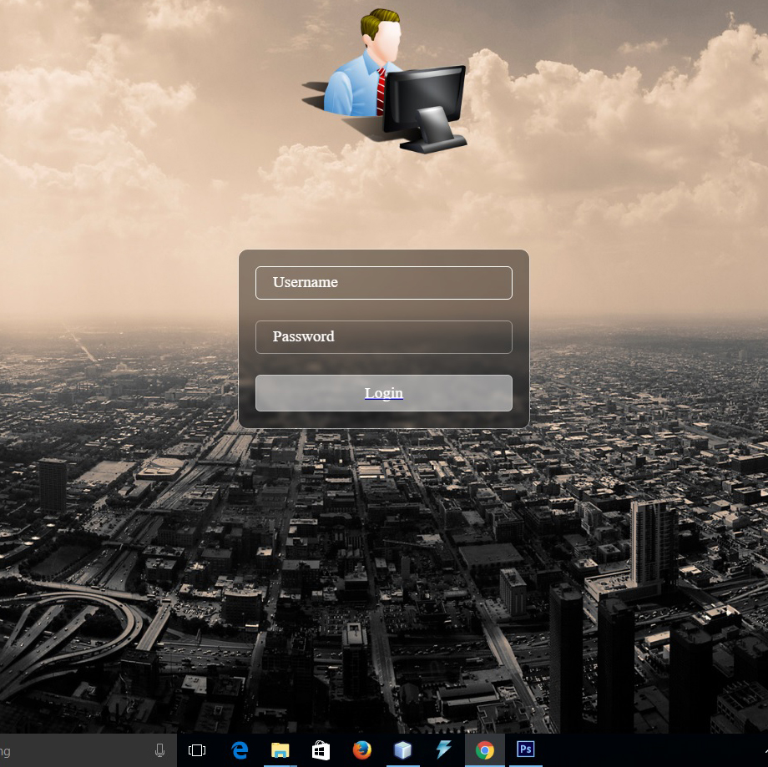
Login Page

Slide 8
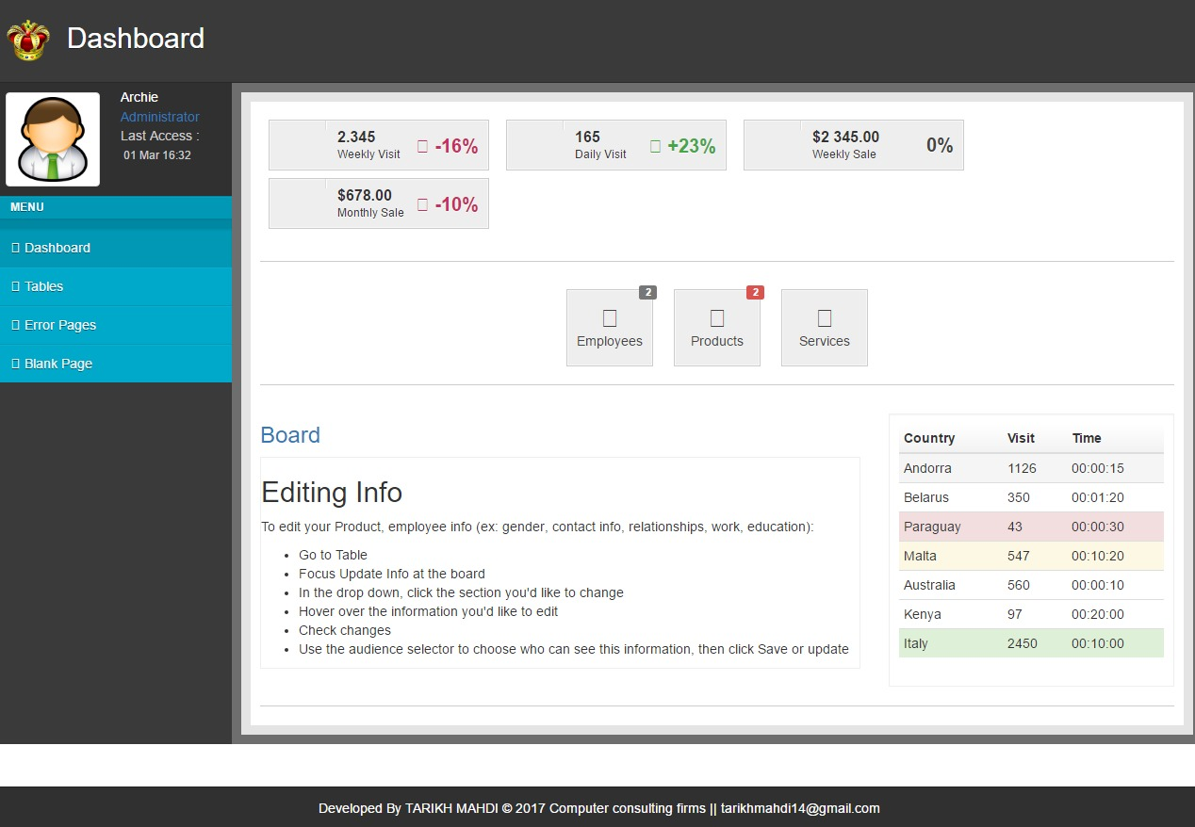
Dashboard

Slide 9
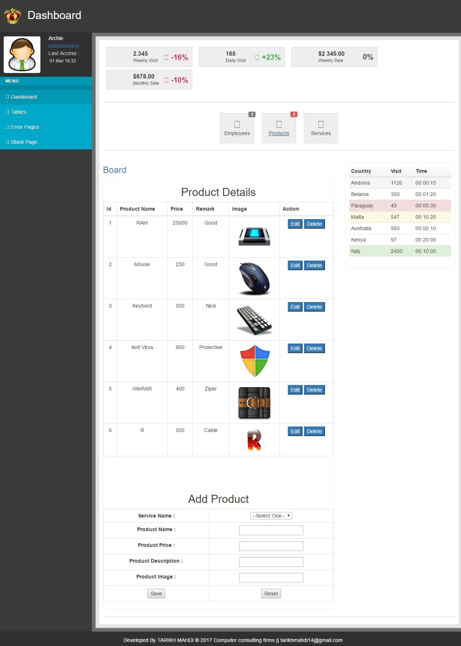
Add Product

Slide 10
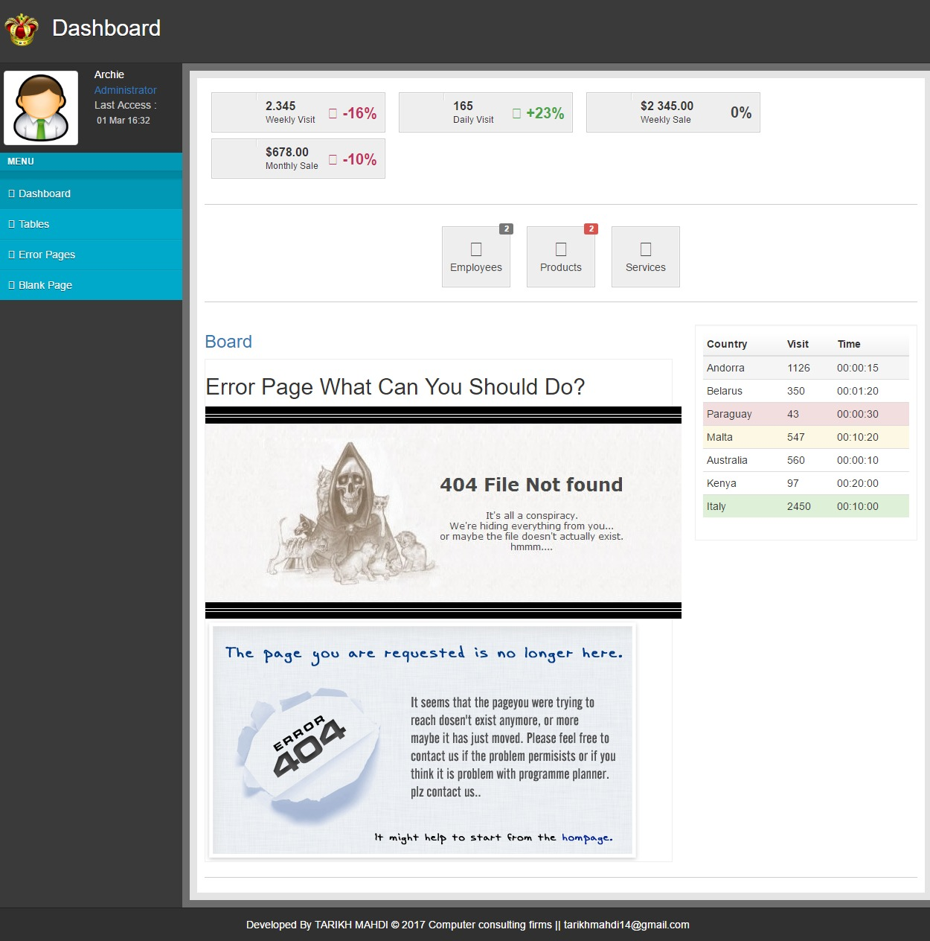
Error Page

Slide 11
THANK YOU FOR WATCHING

